Slide 1


Dr.Dowlah/Fall2016

Slide 2
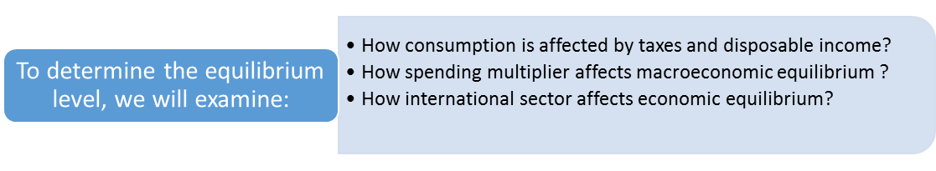
In Macroeconomics—equilibrium is the level of income and expenditures that the economy tends to move toward and remain at until autonomous spending (expenditure) changes.
Dr.Dowlah/Fall2016

Slide 3
Fiscal Policy deals with government expenditures (purchases and transfers) and government revenues (taxation policies).
Monetary Policy deals with controlling money supply in an economy.
Because monetary and fiscal policies can influence Aggregate Demand, governments often use these instruments to stabilize the economy.
Dr.Dowlah/Fall2016

Slide 4

Non-discretionary/ Mandatory/Entitlement spending—Previous laws require that money be spent
  Social Security, Medicare, Medicaid, and Welfare.
  Interest on National Debt
Discretionary Spending—annual appropriation bills must be passed for the money to be spent
  Defense, International Policy, Foreign Aid and so on.
Dr.Dowlah/Fall2016

Slide 5
Discretionary Fiscal Policy—results from deliberate changes in taxes, purchases, transfer payments policies of the government. These are normally initiated by an Act of Congress—requiring change in a spending program or tax laws.
An increase in defense spending, or a cut in tax rate, or the Economic Stimulus Package given by President Obama, are examples of such Fiscal Policies.
Non-discretionary fiscal policies result from the past laws of the country. These laws result in mandatory/entitlement spending by the government.
Dr.Dowlah/Fall2016

Slide 6

Closed Economy = Consumption + Investment + Government Purchases= C + I + G
Open Economy = C+ I + G + X –M
MPC = Change in Consumption/Change in Yd. MPS= Change in Saving/ Change in Yd. MPC + MPS = 1 MPC = 1- MPS. MPS = 1- MPC
Dr.Dowlah/Fall2016

Slide 7

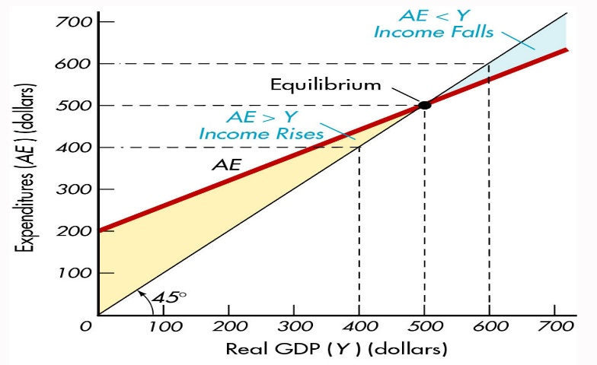
The Economy is at equilibrium when AE=Y
When AE is above Y, Inventory in the economy must be falling. Thus Real GDP should increase to bring the economy to equilibrium. If AE is below Y, inventory must be rising. Thus, real GDP should decrease to bring the economy to equilibrium.
Dr.Dowlah/Fall2016

Slide 8
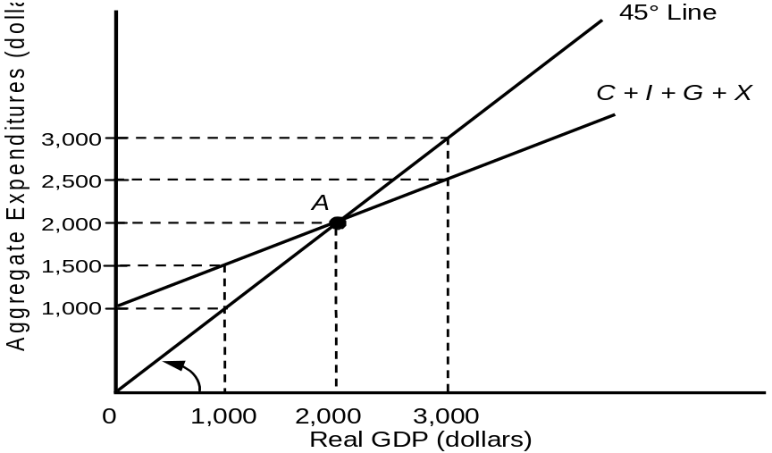
Review question? What is the equilibrium GDP in this graph?
Dr.Dowlah/Fall2016

Slide 9
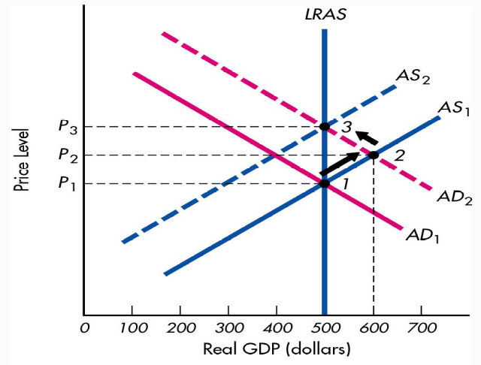
The natural level of real output = $500bn
The points that reflect natural level of real output are 1 and 3, which are also long-run equilibriums. Three curves that must intersect for long-run equilibrium are: AS(LR), AS (SR) and AD.
Short-run equilibrium when two curves intersect= AS Short-run and AD curve.
Dr.Dowlah/Fall2016

Slide 10

Spending multiplier refers to any change in autonomous expenditures that multiplies into a larger change in equilibrium real GDP.
Expenditure Multiplier (closed economy)
= 1/(1-MPC) = 1/MPS (as MPS= 1-MPC)
If MPC is 0.75, expenditure multiplier is: 1/ (1-0.75)= 1/0.25= 4
Dr.Dowlah/Fall2016

Slide 11
Spending multiplier (open economy) =1/(MPS + MPI)
Open economy means an economy with international sector.
If MPC = 0.75, then MPS = 0.25.
If MPI is 0.10, then the expenditure multiplier will be : 1/(MPS+MPI) = 1/(.25 + .10)= 1/.35= 2.86.
That means, spending multiplier is smaller in an open economy, compared with a closed economy
.
Dr.Dowlah/Fall2016

Slide 12

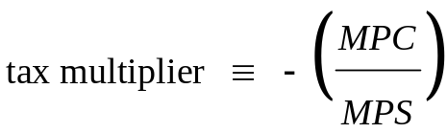
If MPC = 0.70 and MPS = 0.30 then Tax Multiplier will be = - (0.70/0.30) = -2.33.
Tax Multiplier is always a negative number because a change in taxes moves income and expenditures in the opposite direction.

Slide 13

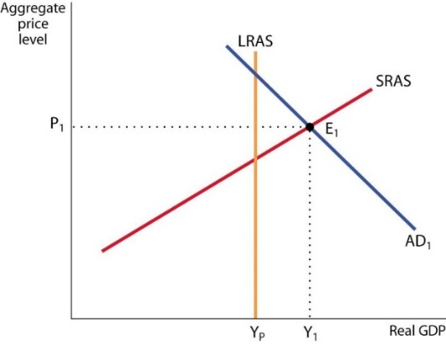
Suppose GDP gap is (YP-Y1) = $1000
Suppose we want to close the expansionary gap by using the instrument of taxation. Suppose MPC is 0.75, then MPS is 0.25. Tax multiplier = - (MPC/MPS) = - (.75/.25) = -3.
GDP Gap = $1,000 billion. Expansionary Gap = GDP Gap/Tax Multiplier = $1000/3 = $333.33bn. That means, you have to raise taxes by $333.33bn to close the GDP gap through taxation.
Dr.Dowlah/Fall2016

Slide 14

To understand how Fiscal Policy works, and how a government can use fiscal policies to stabilize an economy, we need to understand some concepts as follows:
GDP Gap: The gap between a country’s potential GDP and actual GDP.
GDP Gap = Potential GDP - Actual GDP
Recessionary Gap refers to the increase in expenditures required to reach the potential level of GDP
Recessionary Gap = GDP Gap/Spending Multiplier
Dr.Dowlah/Fall2016

Slide 15
Potential GDP—The economy at Full employment level.
GDP Gap= Potential GDP-Actual GDP
GDP gap is negative—you have an expansionary economy
GDP gap is positive—you have a recessionary economy
Recessionary Gap = GDP Gap/Spending Multiplier
Expansionary Gap = GDP gap/Spending Multiplier
Spending Multiplier= GDP Gap/Expansionary or Recessionary Gap
Dr.Dowlah/Fall2016

Slide 16

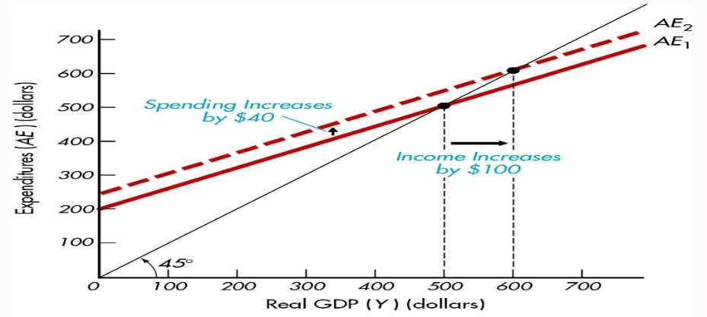
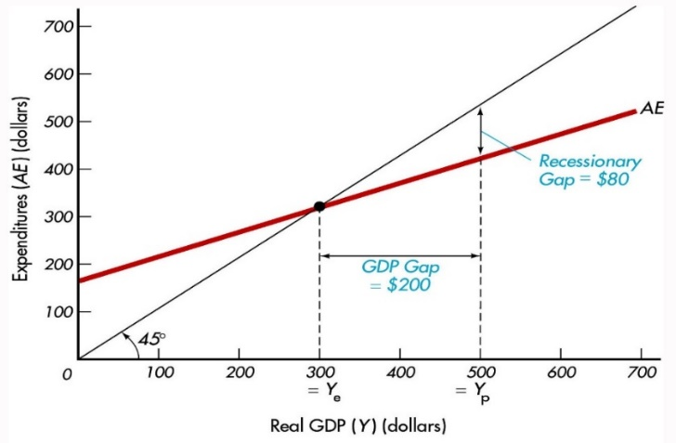
In the left panel, government spending increases by $40 billion, that translates into an increase of $100 billion in real GDP. What is the spending multiplier?
In the right panel, GDP Gap=$200bn
Recessionary Gap = $80bn.
What is the spending multiplier?
Dr.Dowlah/Fall2016

Slide 17

Automatic fiscal policies are triggered by the state of economy. They are associated with changes in real output, the price level, and interest rates in the economy.
For example, an increase in unemployment induces an increase in payments to the unemployed, and a fall in national income induces a decrease in tax receipts.
When an economy experiences a recession, economic growth falls, unemployment rises, and as a result, transfer payment rises, and budget deficit goes up. On the other hand, during an economic expansion—economy grows, tax receipts rise, transfer payment falls, and as a result, budget deficit falls
Dr.Dowlah/Fall2016

Slide 18

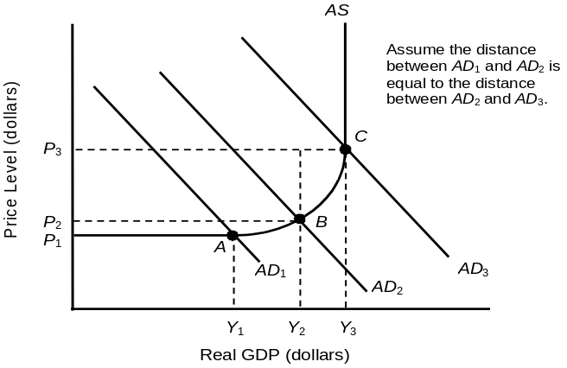
An increase in government purchases or a cut in taxes shifts the aggregate-demand curve to the right.
A decrease in government purchases or an increase in taxes shifts the aggregate-demand curve to the left.
But there are two macroeconomic effects that cause the size of the shift in the aggregate-demand curve to be different from the change in the level of government purchases.
Dr.Dowlah/Fall2016

Slide 19

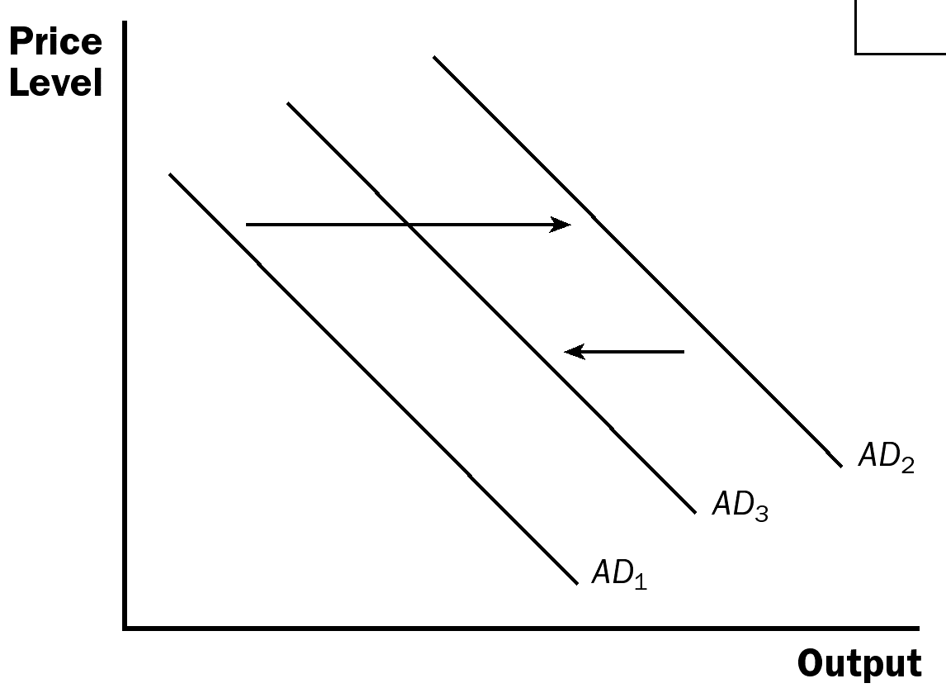
The multiplier effect tends to amplify the effects of fiscal policy on aggregate demand.
On the other hand, the crowding-out effect tends to dampen the effects of fiscal policy on aggregate demand. The crowding-out effect works in the opposite direction.
Dr.Dowlah/Fall2016

Slide 20

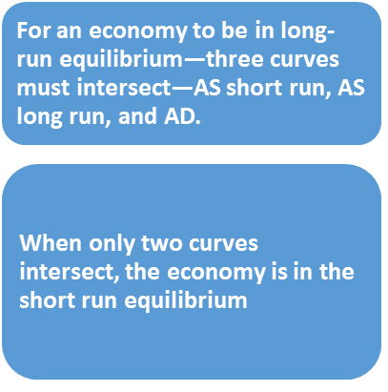

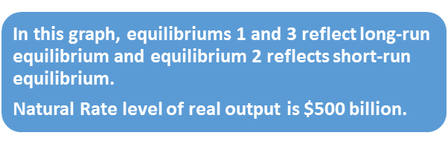

Slide 21

MPC + MPS = 1
MPC = 1-MPS
MPS = 1-MPC
You know one, you know the other too
APS + APC = 1
APS = 1-APC
APC = 1-APS
You know one, you know the other one too.

Slide 22

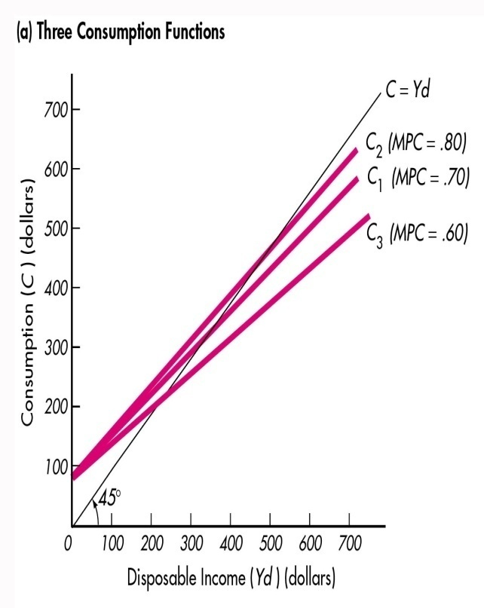
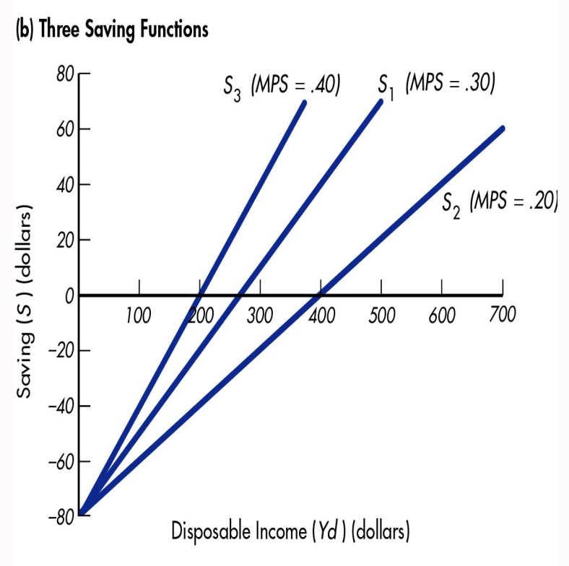
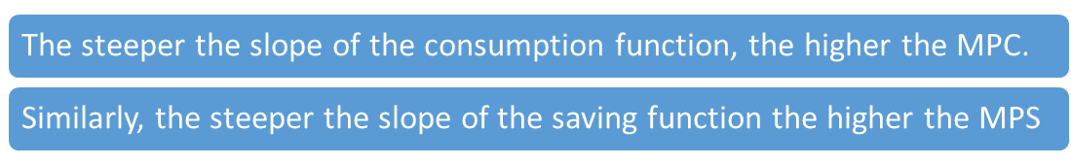

Slide 23
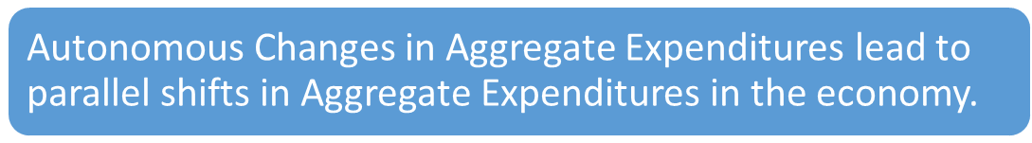
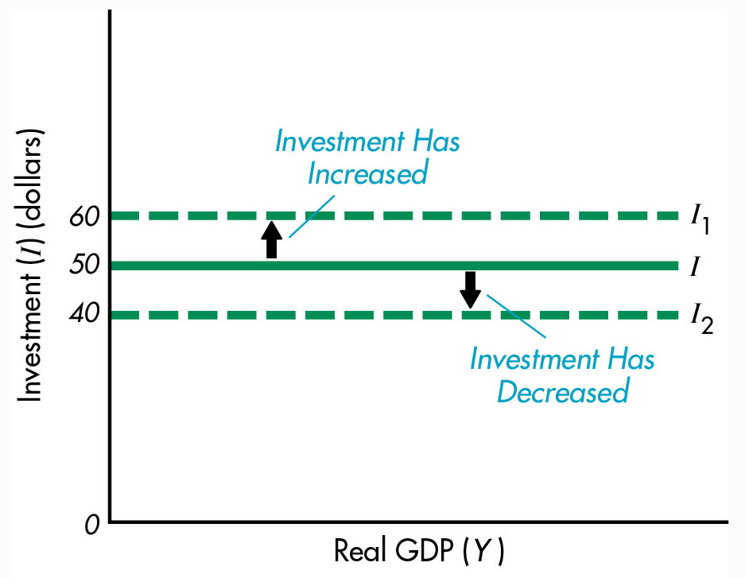
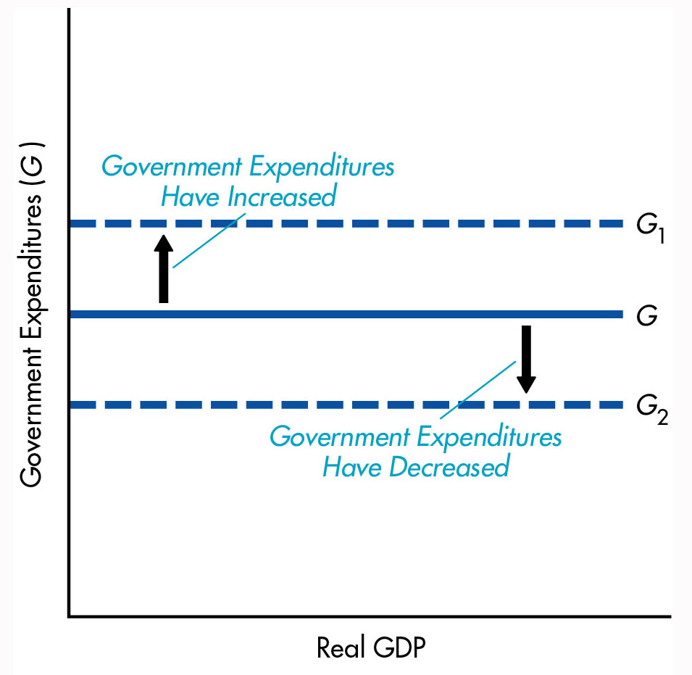

Slide 24
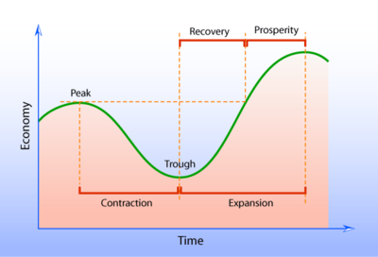
Peak: When economy reaches its possible highest point at a given point of time– unemployment falls, inflation rises, and economic growth rises.
Contraction (recession)—when economic growth is falling, unemployment rising, and inflation falling.
Expansion (recovery)—when economy picks up—moves away from trough— unemployment is falling, inflation rising , and economic growth rising
Trough—when an economy reaches its bottom—can’t go down any more.
Dowlah/Fall2014

Slide 25

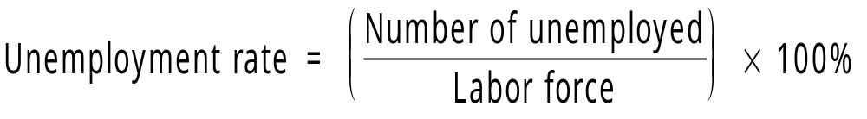
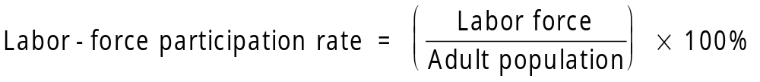

Slide 26

In Keynesian Economics—founded by John Maynard Keynes—the Aggregate Demand plays crucial role in the economy.
This is also called Demand-side Economics. AD curve is considered to be Downward Sloping, while AS is considered to be Horizontal.
In classical economics—founded by Adam Smith—Aggregate Supply plays crucial role in the economy. This is also called Supply-side Economics.

Slide 27
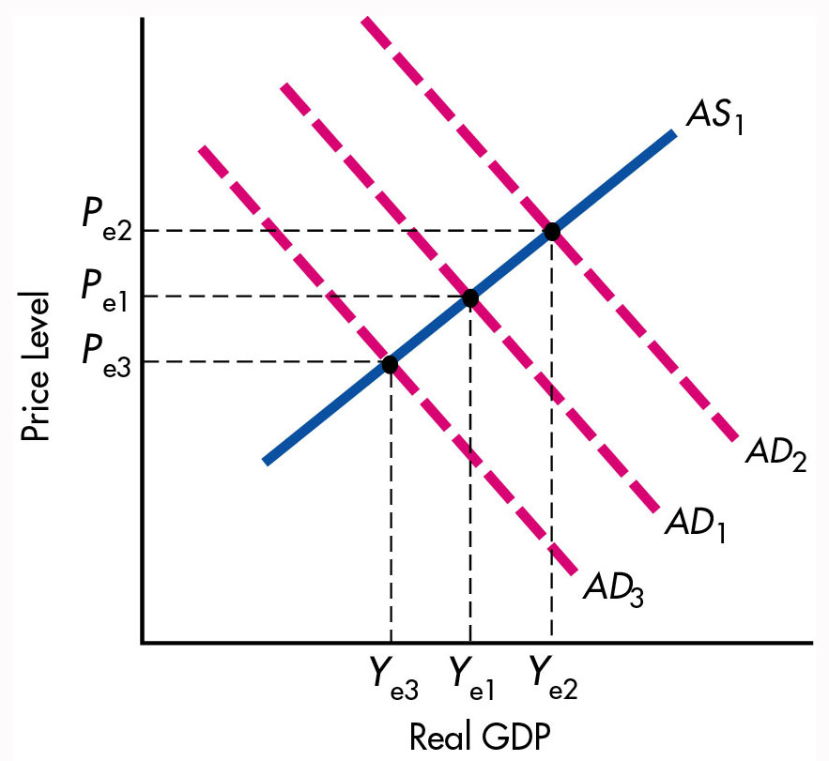
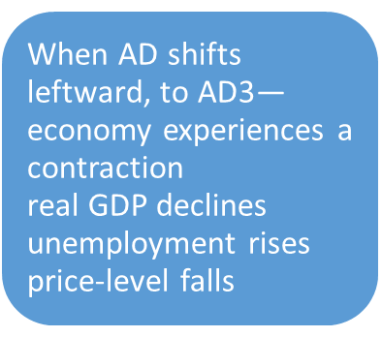

Slide 28

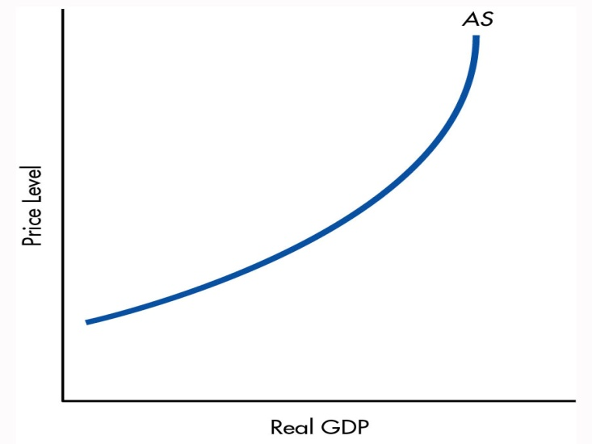
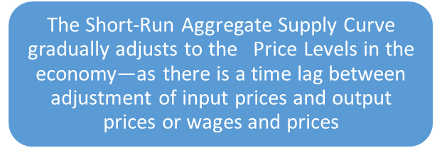
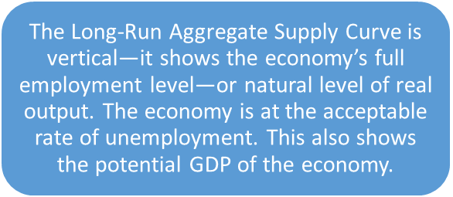
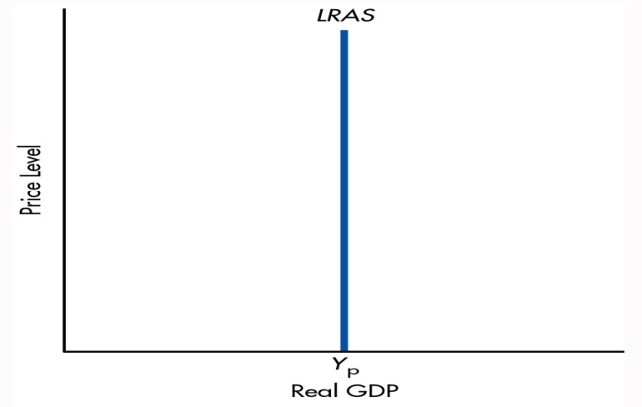

Slide 29
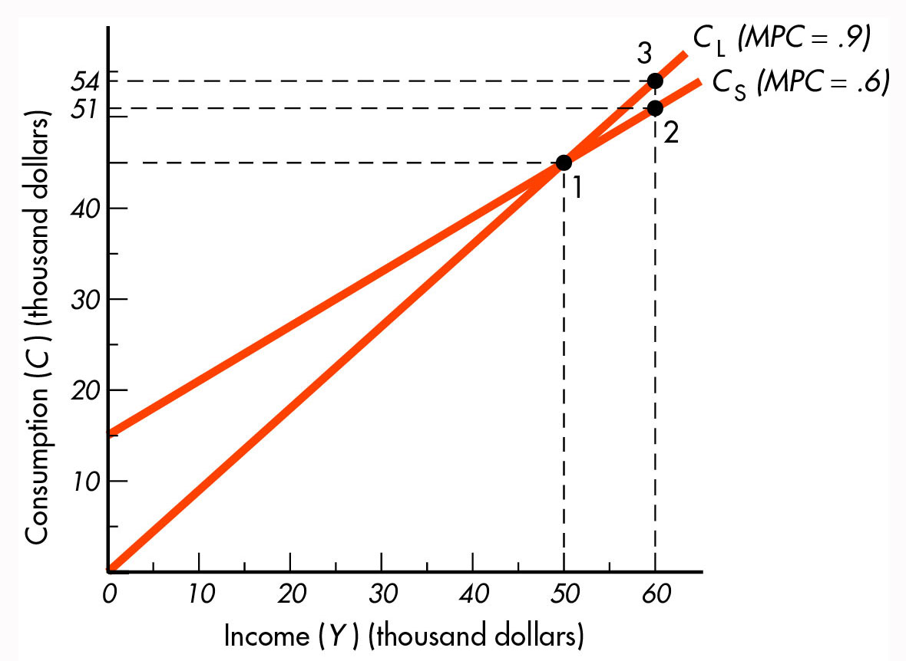
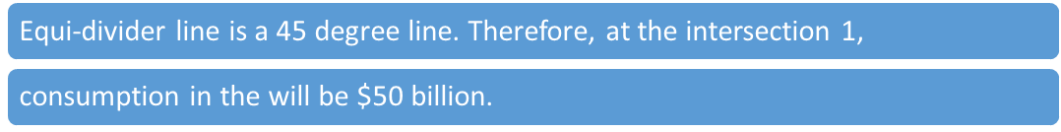

Slide 30
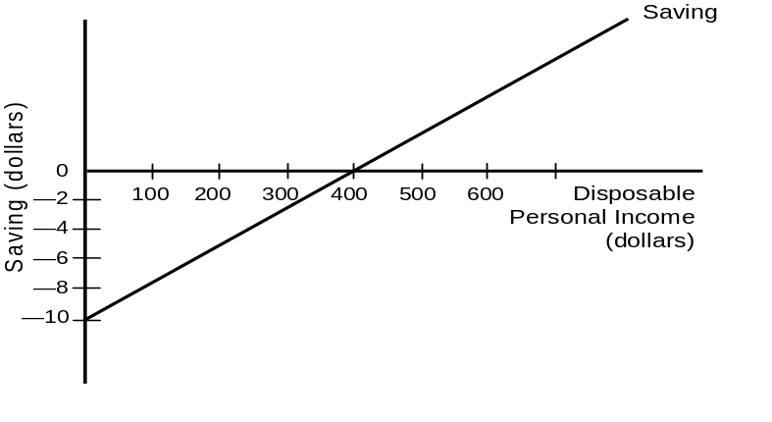
Dr.Dowlah/Fall2016

Slide 31
Years to double income/GDP = 72/ Average annual growth rate
10% average annual growth rate will take = 72/10 = 7.2 years
5% average annual growth rate will take = 72/5= 14.4 years

